Slide 1
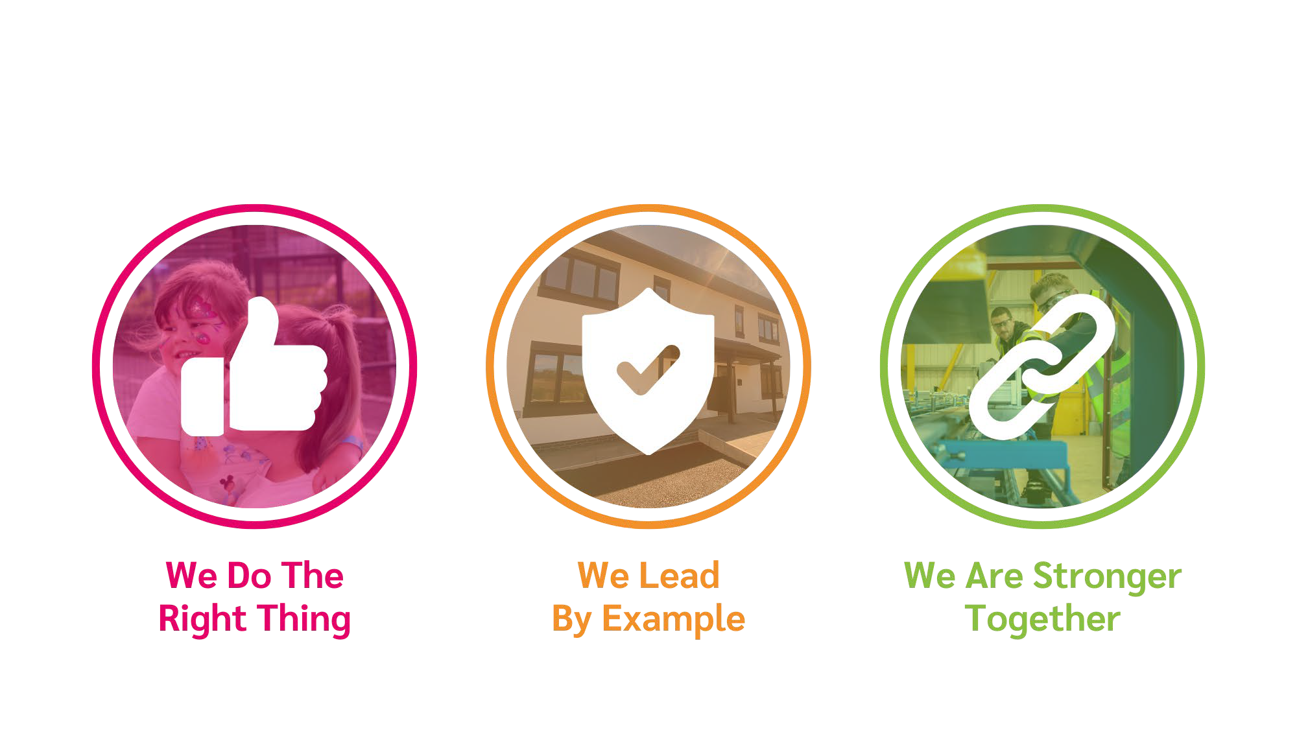
Customer Promise
Creating our customer promise – what is it?
The customer promise sets the level of service our colleagues are expected to provide. It is about the whole experience the customer should experience at every touch point in their customer journey.
The promise was created in partnership with colleagues and tenants. Both feeding into what the important elements of an excellent customer experience should include
Why is it important?
Delivering the promise will help to build trust by delivering a consistent and customer focused service
Customers know they can rely on us to meet their needs.
Creates a sense of security and confidence.
The customer promise will be a key part of our focus on People in our Together Corporate plan. The Promise will help us to work as one, centring on the well being and development of tenants and colleagues, creating a supportive, inclusive and accessible organisation.

Slide 2
Customer Promise: Together we THRIVE
Tell us Once
Contact with us is easy, we will listen and act on what needs to be done for the customer. If a customer gives you information or asks a question, take ownership, deal with it and get back to the customer.
Helpful and Accessible
Customers can approach us for all their housing needs. We will be helpful and empathetic and recognise the customer's circumstances and feelings.
Reliable
Customers can rely on us to be ready to listen and do what we say we will do. We keep in touch with customers, so they know what's happening.
Inclusive
We treat customers with respect and value diversity. We will recognise customer’s individual needs and adapt our service to meet those needs.
Value
We value customer input and we give customers the opportunity to influence the way our services are managed.
Empower
We empower customers to:
use the information available to them to manage their homes and tenancy independently, and to
speak up and challenge us to help improve the way we do things.

